Slide 1


Why should my child read at home daily?

Slide 2
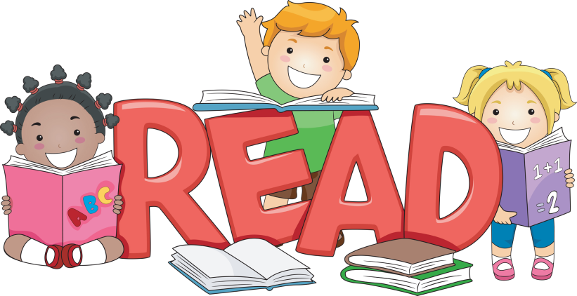
Why is daily reading so important?
Reading is a fundamental building block for success. It develops the mind, and is an essential part of cognitive and linguistic growth.
Benefits of Daily Reading:
Vocabulary Enhancement
Improved Critical Thinking Skills
Memory Improvement
Increase in Visualization and Imagination
Improved Focus
Stress Reduction

Slide 3
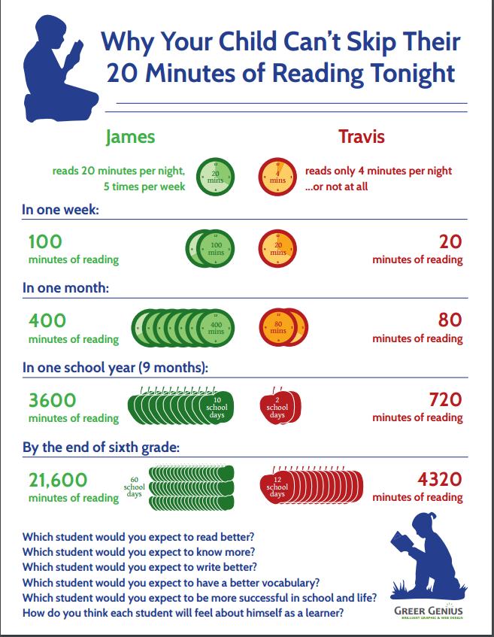
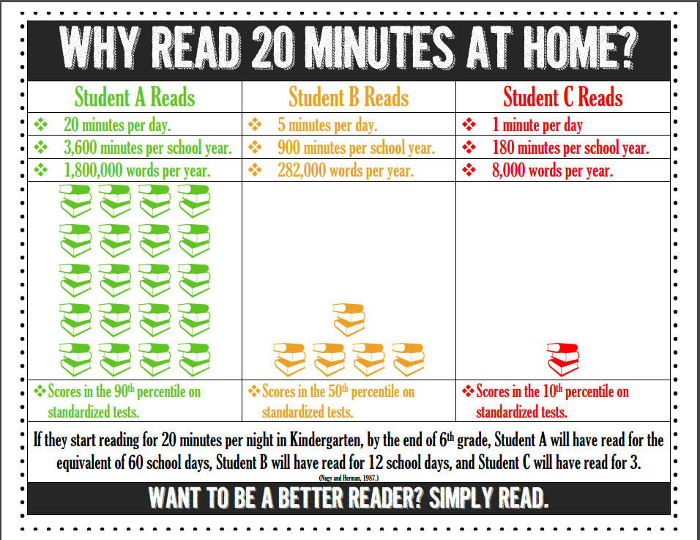
How important is daily reading?

Slide 4
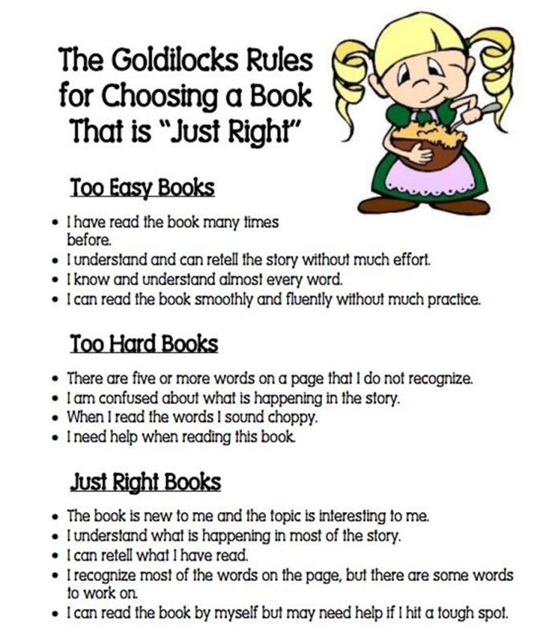
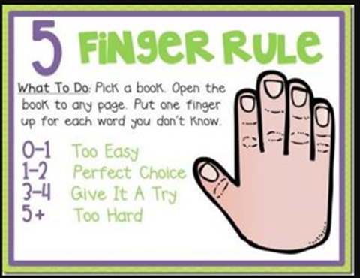
Selecting “Just Right” Books
Have your child select a book that interests them
Open up to a page in the book and have your child read it
Each time they encounter a word that they do not know, have them put a finger up
Five or more unknown words means that the book is too challenging for your child at this time

Slide 5
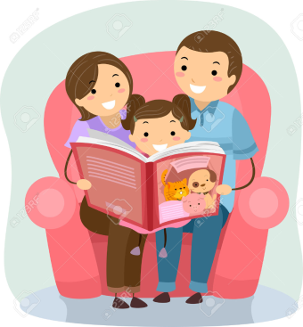
How can parents support reading at home?
Reading at home is extremely beneficial to your child’s education, as well as the bond you share with your child. You can support your child’s reading at home in many ways.
Listen to your child read aloud
Take turns reading aloud with your child
Read aloud to your child at any age!
Discuss books with your child
Ask questions about the books they are reading or have read
Visit the local library with your child
*The most important thing is to be a reading role model. If children see adults enjoying reading, they will enjoy reading as well!*

Slide 6
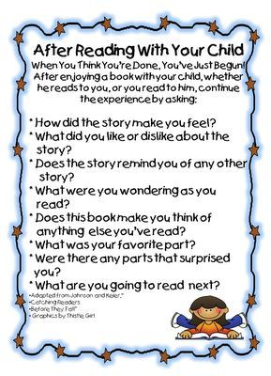

Slide 7


How can parents track reading at home?
Reading Logs
Reading Responses
Journals
Questions and conversations about the book
Book Clubs
Communication with the classroom teacher

Slide 8

How can parents encourage reading during the school year?
Provide opportunities for reading after school
Discuss books and genres that your child enjoys
Listen to your child read
Read to your child
Take trips to books stores or the local library
Ask questions about the books your child reads
Make a fun reading spot in your home

Slide 9
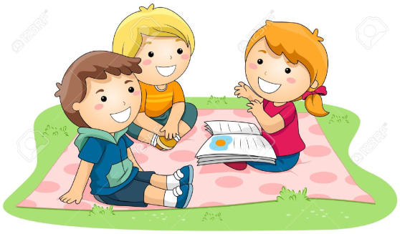
How can parents encourage reading during the summer?
Take part in summer reading games and challenges
Attend events at your local library or book store
Read books, newspapers, magazines, tablets, audio books, or even subtitles on the television
Read the road signs while traveling
Read in different locations (beach, park, lake, etc.)
Play word games
Have fun with it! Reading should be for enjoyment and learning new things.

Slide 10
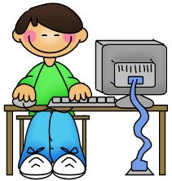
Fun Reading Websites!
Starfall
starfall.com
Raz-Kids
kidsa-z.com
Storyline Online
storylineonline.net
Read to Me
readtomelv.com

