Slide 1
Nest survival of wild turkeys Meleagris gallopavo silvestris in a mixed-use landscape: influences at nest-site and patch scales
By Angela K. Fuller, Shelley M. Spohr, Daniel J. Harrison & Frederick A. Servello
Wildlife Biology 19:138-146(2013)
Presented by Erum Hadi, MPH, MsEd

Slide 2
Useful Terms and Abbreviation
Patch-Scale – fragmentation, edge, dominant land cover
Patch-Density- amount of vegetation near nest site
Fragmentation –
Survival rate –
Notes:
A main concept in landscape ecology is scale. Scale represents the real world as translated onto a map, relating distance on a map image and the corresponding distance on earth.^{[34]} Scale is also the spatial or temporal measure of an object or a process,^{[27]} or amount of spatial resolution.^{[5]} Components of scale include composition, structure, and function, which are all important ecological concepts.
Patch, a term fundamental to landscape ecology, is defined as a relatively homogeneous area that differs from its surroundings.^{[5]} Patches are the basic unit of the landscape that change and fluctuate, a process called patch dynamics. Patches have a definite shape and spatial configuration, and can be described compositionally by internal variables such as number of trees, number of tree species, height of trees, or other similar measurements.

Slide 3
Introduction
Annual wild turkey population change depends greatly on nest survival. Most nest failures occur due to predation, and are in suburban versus rural areas.
Decreased success of nest may also relate to sparse vegetation, habitat composition, and fragmentation, or other landscape processes such as high carnivore density.

Slide 4
Introduction
Successful nests are well hidden from predators by vegetation cover.
Many studies explain the “within patch” conditions of a turkey nesting site, but few look at patch-scale characteristic.
This study examines nest-site and patch-scale variables on daily survival rate of turkey nests.
Notes:
This study had the opportunity to look at a fragmented mixed-use landscape to evaluate the importance of fine-scale (within nest site) vegetation vs fragmentation and edge influences at the patch scale on daily nest survival of turkeys in suburban areas with high density of roads and patch-interface edges and high variability in composition and configuration between home ranges of nesting hens.

Slide 5
Literature Review
Turkey populations depend on nest survival.
Roberts et al, 1995: Survival and reproduction of female wild turkeys in New York – Journal of Wildlife Management 59:437-447.
Roberts & Porter 1996: Importance of demographic parameters to annual changes in wild turkey abundance – Proceedings of the National Wild Turkey Symposium 7:15-20.
Roberts & Porter 1998: Relation between weather and survival of wild turkey nests. – Journal of Wildlife Management 62: 1492-1498.
Thogmartin & Schaeffer 2000: Landscape attributes associated with mortality events of wild turkeys in Arkansas. – Wildlife Society Bulletin 28:865-874.
Turkey ground nests are heavily predated on in suburban woodlots, because predators and prey are pushed closer by human housing.
Wilcove, DS, 1985: Nest predation in forest tracts and the decline of migratory songbirds. – Ecology 66:1211-1214.
Vangilder et al, 1987: Reproductive parameters of wild turkey hens in north Missouri. – Journal of Wildlife Management 51:535-540.
Vanger Haegen et al. 1988: Factors affecting productivity in a northern wild turkey population. – Journal Wildlife.
Thomas & Litvaitis 1993, Vangilder & Kurzejeski, 1995
Hoffman & Gottschang 1977, Wilcove 1985, Rosenberg et al. 1999
Thorington & Bowman 2003

Slide 6
Literature Review
More specifically, multi-scale processes such as vegetation, across site habitat, fragmentation of land, and increased carnivore population impact turkey nests.
Thogmartin 1999: Landscape attributes and nest site selection in wild turkeys. – Auk 116:912-923.
Successful nest sites have dense vegetation that provides concealment, are closer to water, away from roads, and areas of high edge density, where mammalian predators in high numbers.
Lehman et al. 2008: Merriam’s turkey nest survival and factors affecting nest predation by mammals. Journal of Wildlife Management 72:1765-1774.
Miller et al. 2000
Thogmartin, 1999
Oehler & Litvaitis 1996

Slide 7
Hypotheses
Daily nest survival would decrease during incubation, because olfactory cues are more pronounced, and the longer a nest is active the more scent trails are left by the hen.
Early nesters initiate egg laying before spring green-up that provide concealment, so we also hypothesized that those nests might be easier for predators to locate.

Slide 8
Materials and Methods
Sample size N=29, 1996 and N=23, 1997 during incubation
Study site: Middlesex and New London counties Southeastern Connecticut
Site: mature forest cover 65-100% , developed land 0-28%, and agriculture land 0-30%.
Forest dominant species: Quercus (oak) and Carya (hickory), with Liriodendron tulipifera (yellow poplar), Ulmus (elm), and Acer rubrum (red maple).
^{2.} EPA USA (1997) Phase 2 report, further site characterization and analysis: volume 2C, data evaluation and interpretation report: Hudson River PCB reassessment RI/FS. New York.

Slide 9
Materials and Methods
Common understory species included Vaccinum (blueberry), Hamamelis virginiana (witch hazel), Cornus (dogwood), Lindera benzoin (spice bush), Kalmia latifolia (mountain laurel), Rubus (raspberry, Viburnum acerifolium (maple leaved viburnum), Rhus radicans (poison ivy) and Smilax spp. (greenbriar).
Mean winter temperature (December-March) was -3.2C in 1996 and 0C in 1997.
Snow depth in 1996 exceeded 15.2cm 39 out of 123 days, but never exceeded 15.2cm in 1997.
Total precipitation April-May was 31cm (7.6cm greater than normal) and 22.3cm in 1997.
Mean spring temperature April-May were 9.8C in 1996 and 8.8C in 1997.

Slide 10
Materials and Methods
Capture, telemetry and home-range estimation
Female turkeys were captured from January to April, 1996-1997, using rocket nets.
Hens were fitted with backpack transmitters with 12 hour mortality sensors, and weighed 89 to 93g (1.95% of body weight)
Hens at capture weighed >=3.2 kg
Hens were monitored 3 times a day > 4 days a week from April to July.
Assumed incubation of hens inactive and at same location for 6 readings.
Scientist kept their distance of 15m to avoid nest abandonment.

Slide 11
Materials and Methods
Incubation period 28 days.
Incubation assumed successful if one egg was hatched.
Analysis restricted to nest survival during incubation.
Evaluated 4th order – nest-site characteristics: i.e., % forest land, % developed land, % agricultural land, and patch density (patch types = forest, agriculture/open land, water and development w/ non-forested land w/human built structures.
Evaluated 3rd order – patch-scale characteristics: distance from nest to nearest road and nearest edge (any boundary b/w any of the four patch types) & perimeter of edge w/in radius that hens travel.

Slide 12
Materials and Methods
Nest-site and patch-scale measurements
Four patch types within the home ranges of hens: forest, development, agriculture/open land and water.
Four variables describing vegetation adjacent to nest site: total stems, % cover above the nest, % understory cover and understory vegetation density.
3 Metrics describing distance to patch type transitions: distance from nest to nearest road, distance from nest to nearest edge and perimeter of edge.
3 variables describing availability of land cover types: % forested land, developed land and agricultural land
1 variable describing density of our four land cover patches within home ranges.

Slide 13
Materials and Methods
FRAGSTATS used to quantify patch-scale metrics within home ranges.
Multicollinearity with Pearson correlation matrix r and because r < .70, we didn’t consider removing variables.
Evaluated patch-density (# of patches/unit area) and the percent of each type within the home range.
Calculated distance from each nest to road
Evaluate patch-scale variables that might influence survival of nests, we quantified linear distance of edge perimeters separating four land cover classes around hens.

Slide 14
Materials and Methods
Measured cover variables around nests and recorded total number of understory stems (woody and herbaceous; <5cm dbh and > 1m height) in four 5X0.5 rectangular plots with a 1 m diameter positioned from 1 m from the nest.
Measured understory vegetation density as woody shrubs and saplings and herbaceous stems <1 m.
Measured understory vegetation in four 1 m diameter circular plots positioned 1 m from the nest bowl in each direction.
Averaged measurements from four plots for both percent understory cover and understory vegetation density.
Estimated percent cover above the nest (<5 cm dbh and >1 m height) with spherical densitometer held 30 cm above the nest.

Slide 15
Materials and Methods
Modeling nest survival
Nest-survival model used in program MARK to evaluate daily nest survival probabilities as function of biologically relevant covariates.
Logit-link function used which bounds estimates of daily survival rate in the (0,1) interval.
Evaluated three hypotheses regarding temporal variation during incubation in daily constant survival model, quadratic trend model, and a linear model.

Slide 16
Materials and Methods
Metrics of patch-scale included: composition, density of different patch types or extent of edge.
Metrics describing composition included: % developed land in home range, % forest land, % agricultural land, and patch density=patch type(forest, development, agriculture/open land and water)
Models including edge included distance from nest to nearest road, distance from nest to nearest edge, and perimeter of edge within the radius of the 25th percentile.

Slide 17
Materials and Methods
Habitat characteristics corresponding to the nest site were described by variables measuring hen concealment, nest concealment or total concealment.
Variables of hen concealment were total stems and percent cover above nests.
Total concealment model included all four variables associated cover around the nest site.
Effects of % understory cover & understory vegetation density on turkey nests, plotted daily nest-survival rates during incubation across range of % understory cover observed during our study at three values of understory vegetation density (low (11/m2), mean (34/m2) & high (69/m2).

Slide 18
Results
The constant daily survival model performed better than the linear trend model or quadratic trend.
Constant model treated daily nest survival as constant throughout the incubation period.
Daily survival rate during incubation increased with increasing % cover around the nest and decreased with increasing understory vegetation density around the nest.
Logistic regression equation for hen concealment model of daily nest survival (s) was logit(S)=2.88+3.93 x %understory cover + -0.037 x understory vegetation density.

Slide 19
Results
Percent understory cover averaged 50% around successful nests (min=4% and max=74%) and 37% around unsuccessful nests (min=6% and max=88%)
Understory vegetation density averaged 25.6/m2 around successful nests (min=4.7/m2, max=66.3/m2), and around unsuccessful nests (min=10.6/m2, max=128.4/m2).
High understory vegetation density and low levels of percent understory cover (<12%), the daily survival rate was <.65, but increased to 0.8 at 36% understory cover.

Slide 20
Results
Daily survival rates differed most at lowest levels of % understory cover, suggesting that high understory vegetation density around a nest didn’t substitute for dense understory cover.

Slide 21
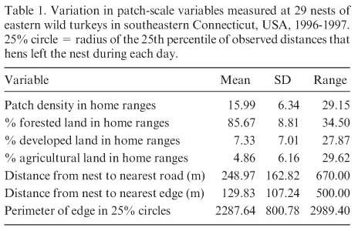
Results

Slide 22
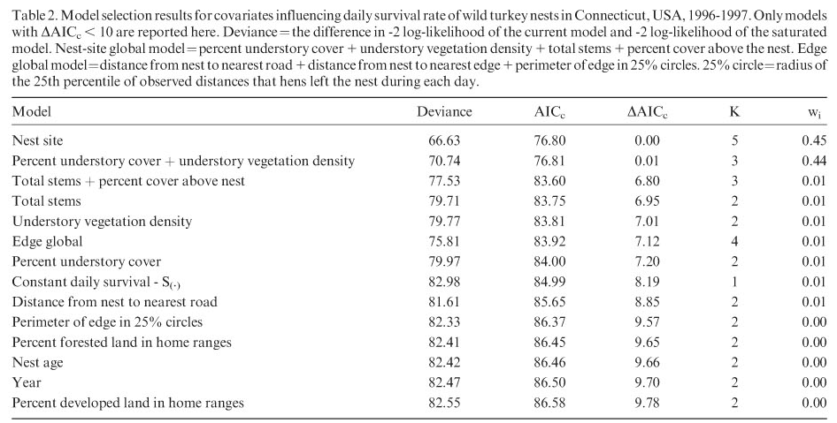
Results

Slide 23
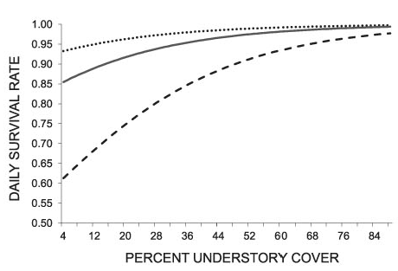
Results

Slide 24
Discussion
Wild turkey nest survival was most strongly influenced by habitat structure around the nest.
Best approximating model, the nest-site covariate, percent understory cover around nests, was 27% greater around successful than unsuccessful nests.
Nest obscurity (dense vegetation) may reduce predator foraging efficiency and increase nesting success by impending movement of potential nest predators.

Slide 25
Discussion
Wild turkey nest survival was most strongly influenced by habitat structure around the nest.
Best approximating model, the nest-site covariate, percent understory cover around nests, was 27% greater around successful than unsuccessful nests.
Nest obscurity (dense vegetation) may reduce predator foraging efficiency and increase nesting success by impending movement of potential nest predators due to blocking of visual and olfactory reception.

Slide 26
Discussion
Coyotes were biggest predators in this study’s mixed use landscape, but they were unable to find the nests in dense understory covered areas.
Rain makes the turkey hens more odorous, and easier to find, but dense cover prevents wetness.
Hens also need escape routes to run from predators, and understory vegetation density was negatively associated with nest survival. (To hide or to flee?)
Patch-scale variables were not strongly supported.
Fragmentation has minor influence, particularly when forest is reduced to <30% of the landscape.

Slide 27
Recommendation
To increase reproductive success of wild turkeys focus on maintaining understory (<1m) densities < 25 stems/m2.

